Slide 1
VIRTUAL SPORTS DAY 2020

Slide 2
House Points so far…
Wilberforce | 169,780
Rowntree | 200,900
Nightingale | 199,992
Tomlinson | 145,972
Owen | 203,079

Slide 3
Welcome to the Wolfreton School Virtual Sports Day! Tuesday 14th July until Thursday 16th July, 3pm.
The PE department invite you to the Wolfreton School Virtual Sports Day for teachers and students to take part in at home!
Like any other sports day, you will be competing against all the other houses to see who will be crowned winners of the Wolfreton School Sports Day 2020!
There are 10 challenges for you to take part in. Each slide will show a different challenge that will require little or no equipment. All are really easy so everyone can take part!
If you only want to take part in some challenges and not all then that is fine but just remember the more challenges you complete, the more points you will receive for your team!
Once you have completed the challenge, click on the link on slide 4 and this will take you to a Form. Simply log in, fill out the information, enter your score and submit the form. If for any reason this does not work, please email your PE teacher with your: Name, Year Group, House and Score.
The PE department will be keeping track of scores and adding up points.
Scores will be available on the website or on Twitter @WolfretonSport
Staff entries are worth double points!

Slide 4
Challenge Index
Number | Challenge | Results Form link
1 | How many kick ups? | Click here to submit your results!
2 | 1 minute sit ups
3 | Speed bounce
4 | 1.5 km run
5 | The plank
6 | Burpees
7 | Standing long jump
8 | Stork stand balance
9 | Standing Shot Put
10 | 4 metre ball throw

Slide 5
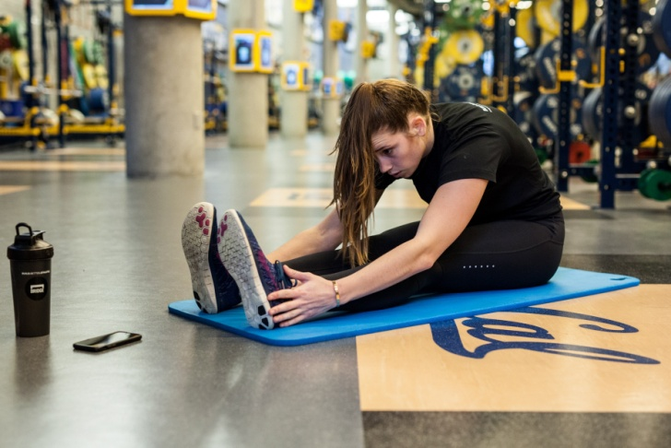
Before you take part in the physical challenges!
It is important you do the following before you take part:
A warm up – You have all been taught the importance of warming up in PE.
Make sure it includes a pulse raiser and stretches to warm your joints and muscles!
Check the environment around you
Is the floor dry and non-slippery ? Do you have enough space? Do you need to clear some things away to make the space safer? Are there any wires/objects you could trip over?
Make sure you are wearing sensible footwear - We advise you wear trainers to protect your feet and give you the most grip!

Slide 6
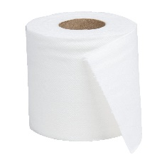
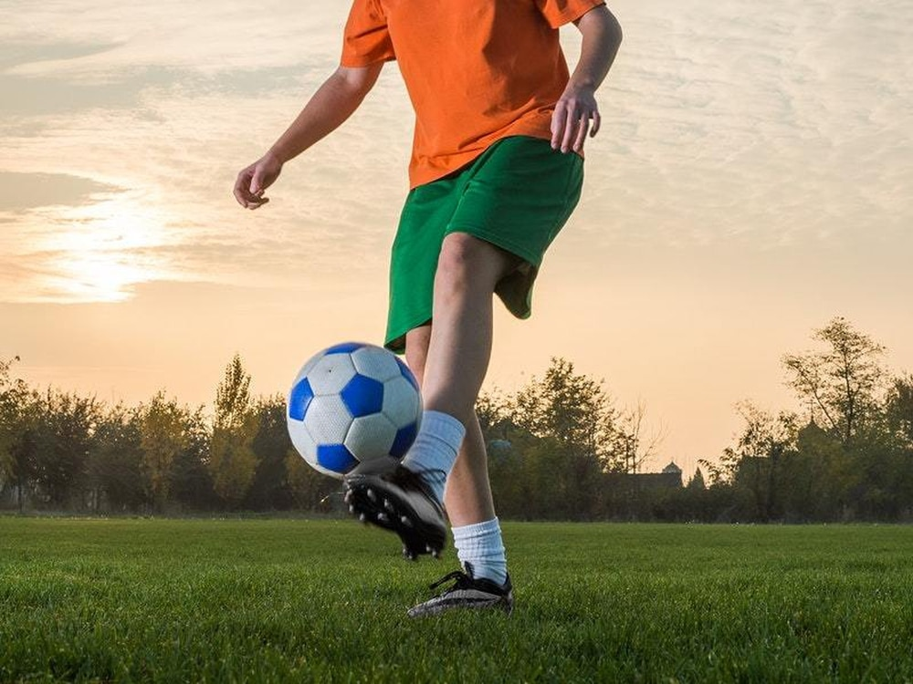
Challenge 1 – How many kick ups?
1. For this challenge you are going to need a ball – you could use a football, balloon, ball made out of socks or a toilet roll.
2. You need to count how many you do consecutively (without the object
touching the floor). This will be your score, keep trying to improve your score.
3. Final score x1 if you have used a balloon, x2 if you have used a football, x3 if you have used a toilet roll or socks e.g. Football total 57 will be 57x2= Total 114
TECHNIQUE
1. Kick the ball using your laces
2. Keep your eye on the ball
3. Maintain an upright posture
Click the link on Slide 4 to upload your score to the PE department!

Slide 7
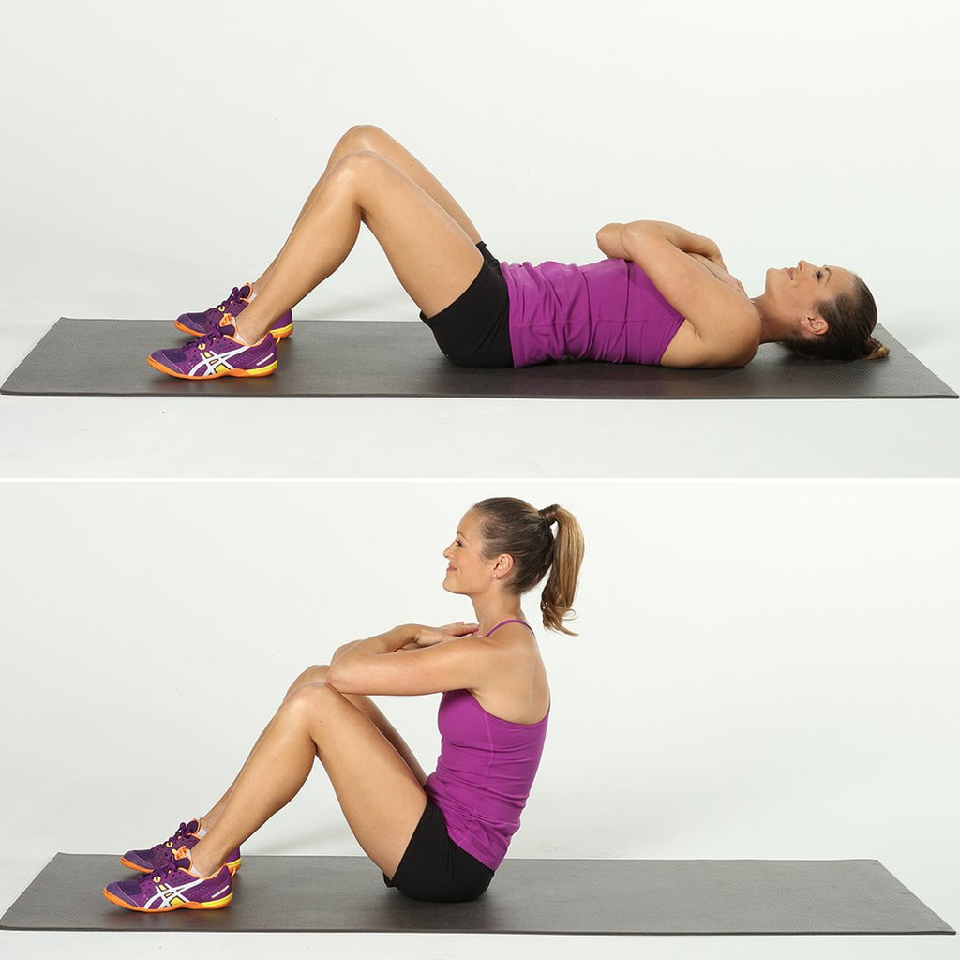
Challenge 2 – Sit Ups in 1 Minute
1. For this challenge you need an empty floor space. You may want to cushion your back with a resistance mat or towel
2. You have 1 minute to see how many sit ups you can do.
3. Clarification: This is a sit up challenge and NOT a crunch challenge so you need to come all the way up to your knees!
TECHNIQUE
1. Lie on the floor with your knees bent and feet firmly on the ground.
2. Cross you arms or put your hands to the side of your head
3. Keep your core tight and come up all the way to your knees
Click the link on Slide 4 to upload your score to the PE department!

Slide 8
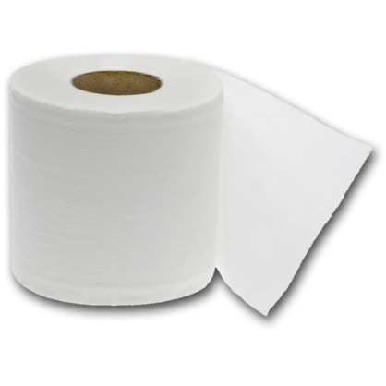
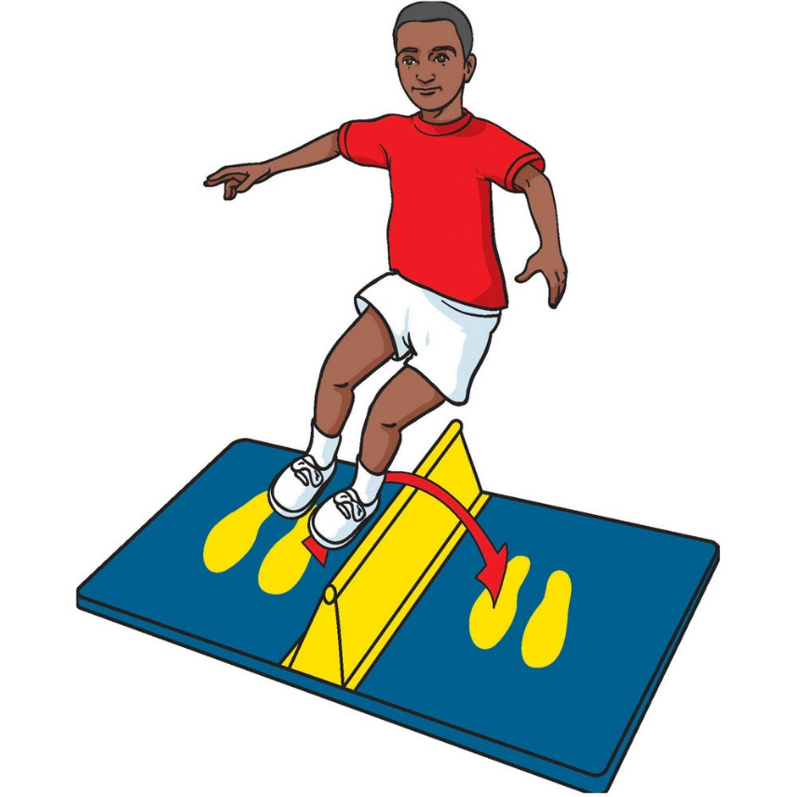
Challenge 3 – Speed Bounce
1. Create a speed bounce – this needs to be something you can jump over.
2. You could use a rolled up towel, a pillow or line of toilet/kitchen rolls.
3. Time how many times you can jump over your object in 1 minute.
4. Each jump over the object counts as 1.
TECHNIQUE
1. It is a two footed jump – 2 feet to 2 feet
2. Bring feet as high as possible
3. Look at your feet for guidance
4. Must jump over the object and try not to touch it
Click the link on Slide 4 to upload your score to the PE department!

Slide 9
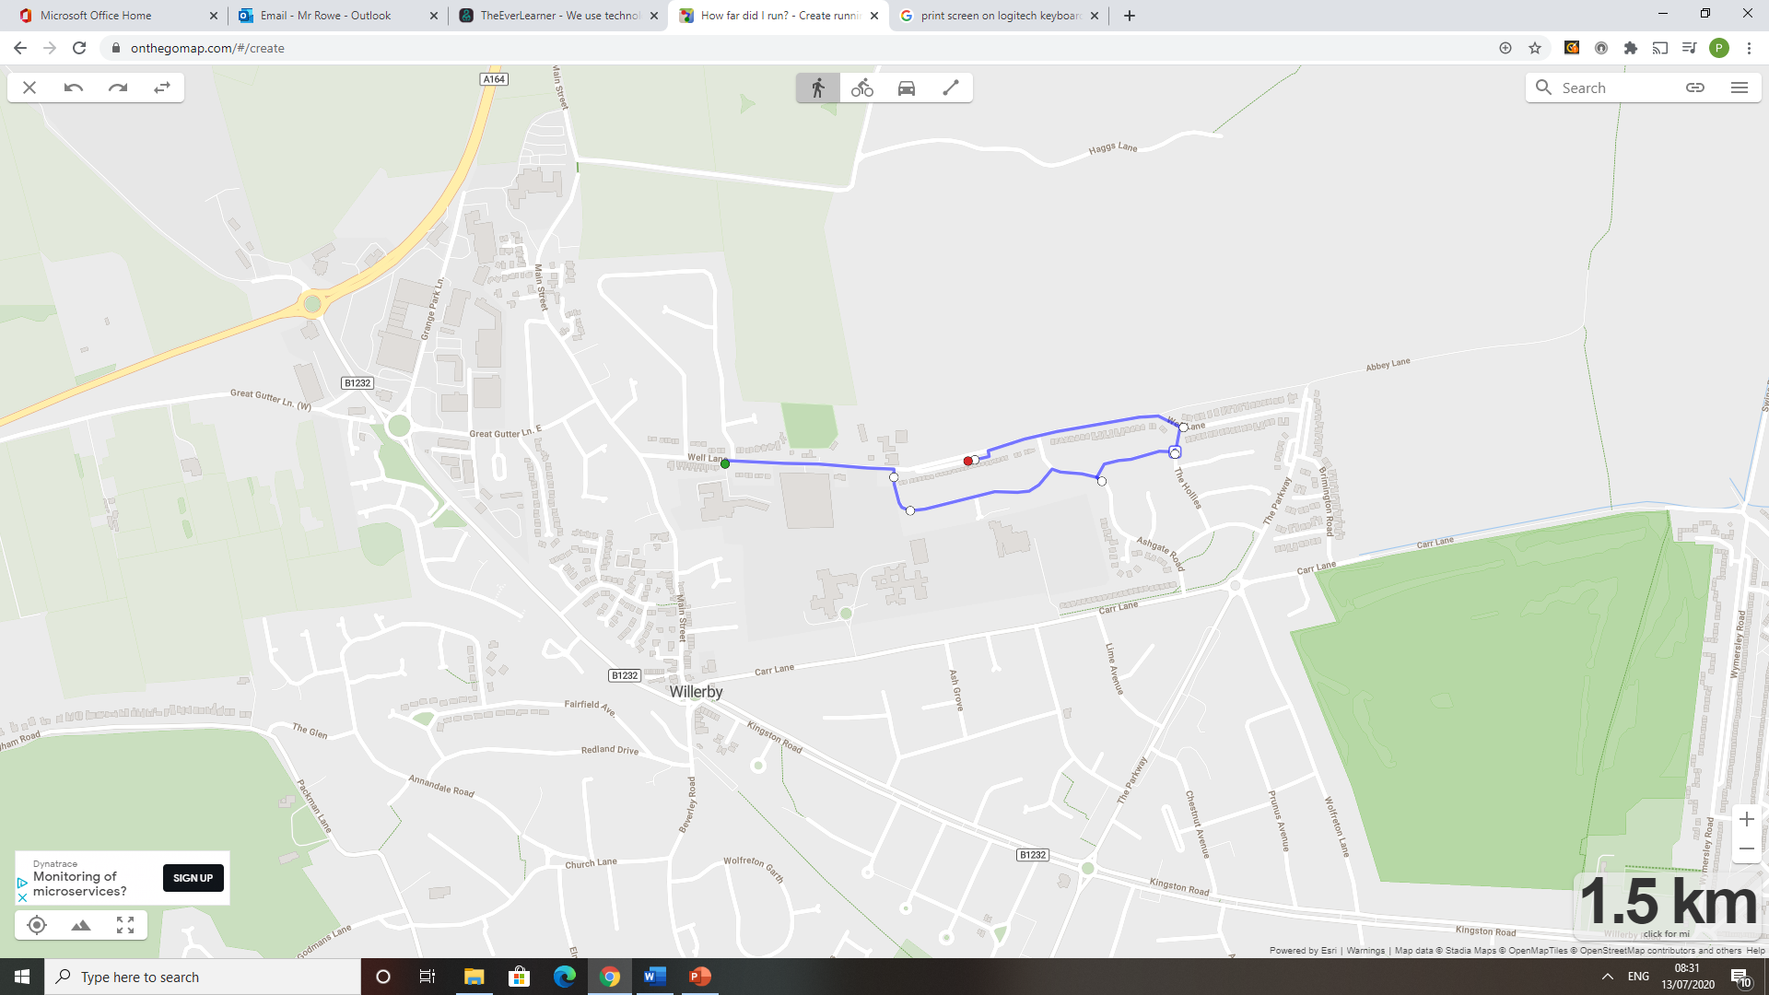
Challenge 4 – 1.5 km Run
1. Measure a 1.5km route near your house using https://onthegomap.com/#/create . Avoid routes where you have to cross roads, paths in local parks would be great for this. Make sure you choose a flat course.
2. If you only have a stop watch, walk for 10-12 minutes (most people cover 1.5 km in this time), then time how long it takes you to run back to your original starting position.
3. Submit how long it took you in minutes and seconds (min:seconds)
TECHNIQUE
1. Keep a steady and consistent pace
2. Could use your non throwing arm to aim at the target
Click the link on Slide 4 to upload your score to the PE department!

Slide 10
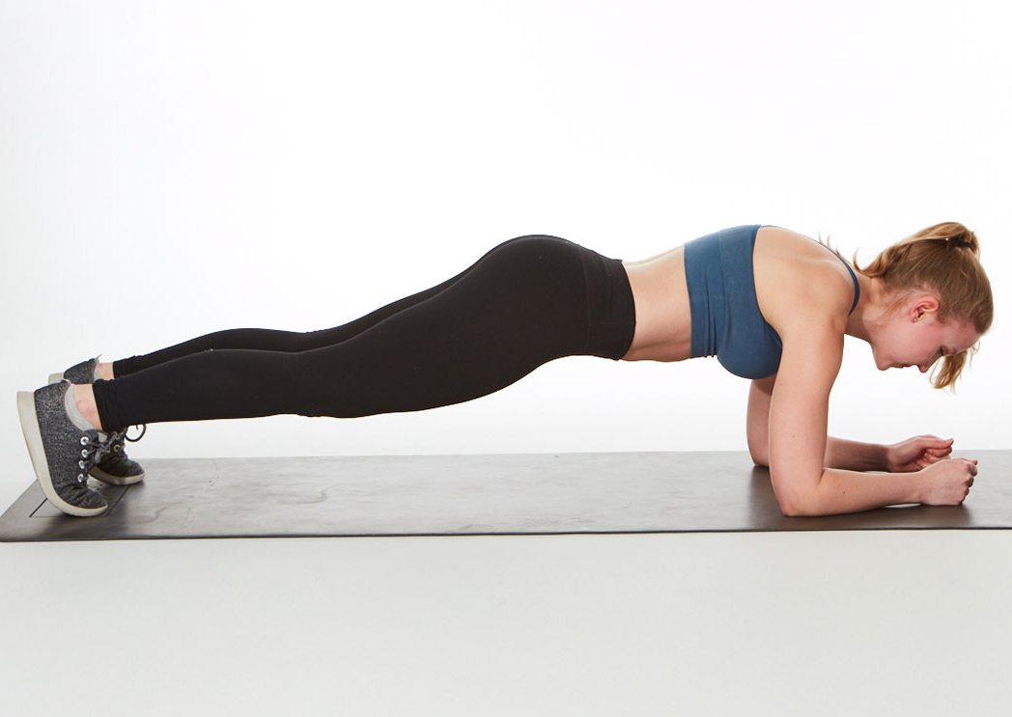
Challenge 5 – Plank Challenge
For this challenge you need an empty floor space. You may want to cushion your elbows with a resistance mat, towel or item of clothing.
Adopt the plank position shown below.
Using a stop watch/phone time how long you can hold this position for. Whatever time you can get to before stopping will be your score.
TECHNIQUE
1. Elbows and hands touching the floor
2. Body needs to stay in a straight line. Hips must not drop too low, bottom must not be too high.
3. Tighten core muscles
Click the link on Slide 4 to upload your score to the PE department!

Slide 11
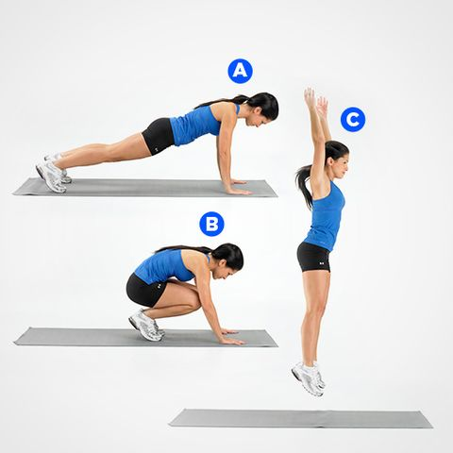
Challenge 6 – Burpees
1. For this challenge you need an empty floor space and a positive mind set as this challenge is a killer!
2. Your challenge is to see how many burpees you can do in 1 minute.
3. You must do a complete burpee (shown below) for it to count as 1. No cheating!
TECHNIQUE
1. Start standing up (c)
2. Jump down to the floor in a tuck position (B)
3. Kick your legs out into a press up position (A)
4. Bring your legs back into a tuck position (B)
5. Jump up and start again (C)
Click the link on Slide 4 to upload your score to the PE department!

Slide 12
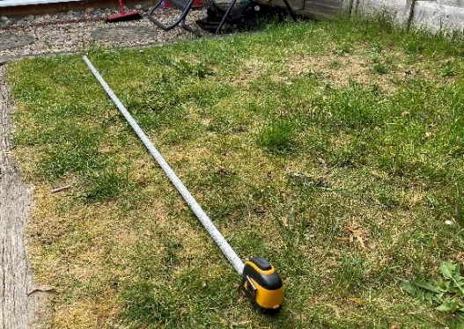
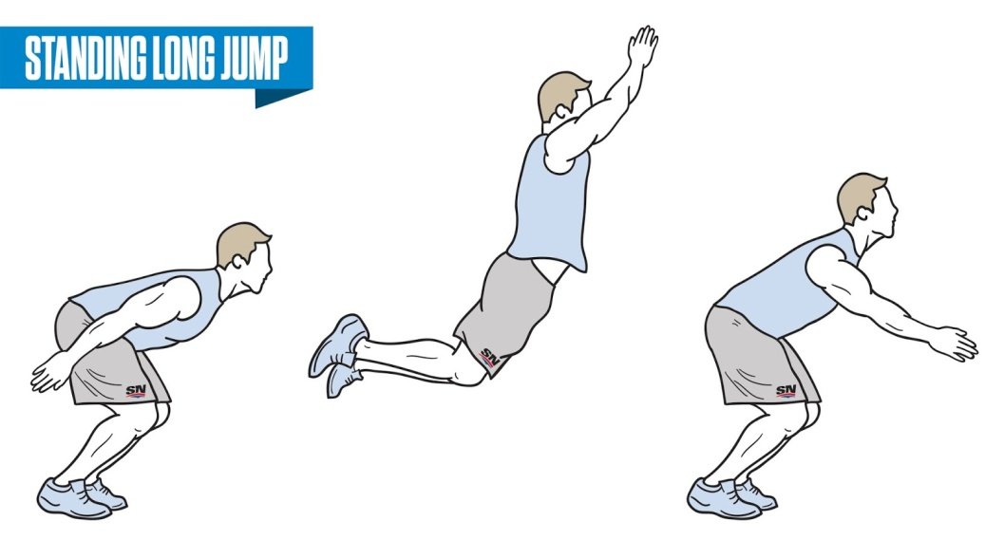
Challenge 7 – Standing Long Jump
1. Find a tape measure and set it up anywhere in your house or garden (as seen below in the photo)
2. Create a start line. This could be a line of string, shoe, towel or item of clothing etc
3. You have three attempts to see how far you can perform a STANDING long jump
then upload your best score.
TECHNIQUE
1. Stand with both feet shoulder width apart, parallel to the start line.
2. Squat deeply and swing your arms backwards.
3. Jump from 2 feet and land on 2 feet.
4. Measure from behind your heal.
Click the link on Slide 4 to upload your score to the PE department!

Slide 13
Challenge 8 – Stork Stand Balance Test
1. Create the Stork Stand balance position shown below
2. Time how long you can maintain this position until you become imbalanced and fall over
3. Whatever time you get to, will be your score.
TECHNIQUE
1. Stand with hands on hips
2. Place the sole of one foot against the side of the kneecap on the other leg
3. Look straight ahead and focus on one point
Click the link on Slide 4 to upload your score to the PE department!

Slide 14
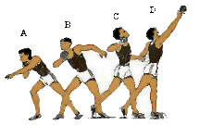
Challenge 9 – Standing Shot Put
1. Find a tape measure and set it up anywhere in your house or garden (as seen below in the photo)
2. Create a start line. This could be a line of string, shoe, towel or item of clothing
3. Make your shot put – this could be a tennis ball or ball made out of socks.
4. You have three attempts to see how far you can throw your shot put and then
upload your best score.
TECHNIQUE
2 1. Stand sideways on
2. Chin, knee and toe all in line
3. Pushing action not a throwing action
4. Transfer body weight from back to front
5. Measure from where the shot put FIRST lands.
Click the link on Slide 4 to upload your score to the PE department!

Slide 15
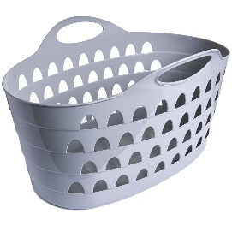
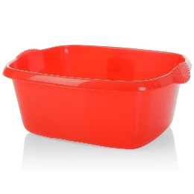
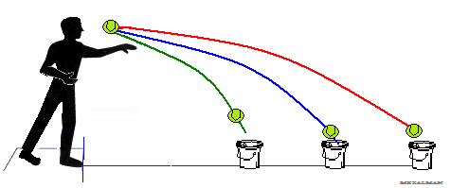
Challenge 10 – 4m Ball Throw
1. For this challenge you need a tape measure to measure out 4m (If not possible then 4 large steps)
2. Create a start line at one end, measure out 4m then place a bucket, washing basket or washing up bowl at the end.
3. Your challenge is to stand at the start line and see how many times out of 10 you can throw a ball and land it in your bucket. Your ball could be a tennis ball, soft ball or a ball made out of socks. Your score will be recorded out of 10.
TECHNIQUE
1. Look at the target
2. You can use your non throwing arm to aim at the target
3. Opposite leg forward to the throwing arm
Click the link on Slide 4 to upload your score to the PE department!

Slide 16
How points will be awarded.
The maximum points for winning each event will be 200 House Points (HP).
The following applies for every challenge in each year group.
If 5 people enter, 1st= 200, 2nd =160, 3rd=120, 4th = 80, 5th= 40
If more than 40 students enter a challenge from the same Year group, the number of entrants will be split over 1000 points.
Every entry will receive 5 house points.
The over all winning House will be awarded the following;
5000 HP
4000 HP
3000 HP
2000 HP
1000 HP

